Slide 1
AC Training for Filgrastim Supplier Change
April 25, 2016
Notes:
Welcome! Today we’ll cover changes to the ordering process and documents for filgrastim. We have selected a new vendor. The new partnership has resulted in a some changes that are important to you.

Slide 2
Purpose
Welcome to today’s training regarding NMDP’s new partnership with Walgreens Specialty Pharmacy (WSP).
Notes:
Today we are going to talk about NMDP’s new relationship with Walgreen’s Specialty Pharmacy. This course is designed to ensure that staff at apheresis centers understand the changes for ordering filgrastim.

Slide 3
In this training you will…
Learn more about the reasons behind the change
Understand changes made to the filgrastim ordering process
Learn how to correctly fill out new and revised forms for ordering filgrastim
Identify which documents and forms have been added or removed
Learn where to go for help when needed
Notes:
In today’s training you will learn about the reasons behind the change and the changes to the ordering process. You will learn about changes to the forms and how to correctly fill out new and revised forms.
You will know which documents and forms have been added and removed and where to go for help when needed.

Slide 4
What We’ll Cover
Why the Change?
About the New Supplier
Trial Objectives and Results
Supplier Transition Timeline and Details
Form Changes
Order and Fulfillment Process
Support Information & Resources
Notes:
The training covers the following items listed on this slide.

Slide 5
Why the Change?
Due diligence paid to vendor selection
Walgreens was selected for the following reasons:
filgrastim pricing
Improved distribution
Experience
Notes:
NDMP went through an extensive selection process, including sending RFPs to several vendors. From a final pool of three we selected Walgreens Specialty Pharmacy for the following main reasons:
Their filgrastim pricing. Walgreens had a significant price break due to their buying power. This offers NMDP a significant savings on the product.
Improved distribution: Walgreens has national coverage with multiple locations for distribution. They are better able to manage emergencies and weather issues. WSP headquarters is in Pittsburgh, which is also the primary shipping location for the filgrastim.
WSP has over 35 years of experience providing specialized medication for complex, genetic, rare and chronic health conditions.

Slide 6
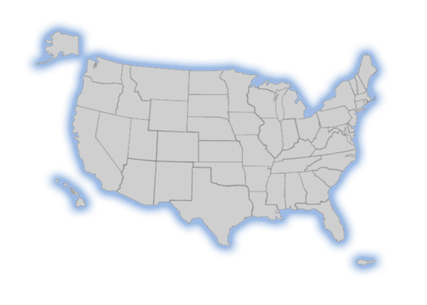
About Walgreens Specialty Pharmacy (WSP)
Pittsburgh serves as the primary ship-from location for NMDP
Full team of dedicated pharmacists and patient care coordinators
Dedicated communication channels via phone, fax, or email
Donor specific dosing and supplies
A large and diverse network to rely upon for managing contingencies
Portland
Canton
Pittsburgh
Frisco
CFS*
Specialty Support Center
*Centralized Cystic Fibrosis Services (CFS) in Frisco
Notes:
Walgreen Specialty Pharmacy offers us unmatched service and care. They have five central locations. The new distribution location near Pittsburgh is the primary location serving NMDP. A full team of dedicated pharmacists and patient care coordinators will assist in getting filgrastim to donors.
Walgreens Specialty Pharmacy is abbreviated to WSP throughout the presentation.

Slide 7
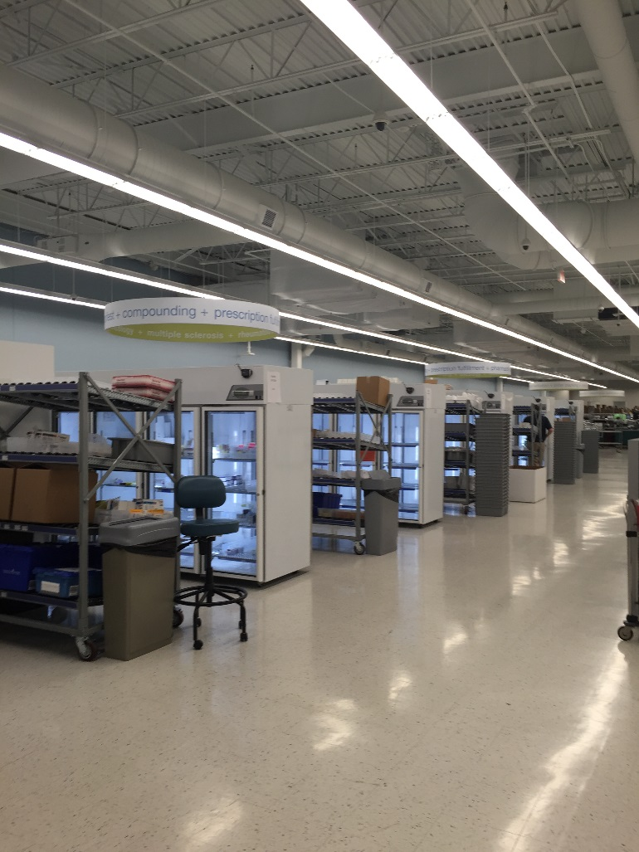
About Walgreens Specialty Pharmacy (WSP)
Professional packaging
Overnight shipping capabilities
Emergency and disaster recovery solutions available with the potential for local pharmacy assistance
Notes:
All figrastim will be professionally packaged for shipment. While it isn’t usually needed, there are overnight shipping capabilities and emergency and disaster recovery solutions available through their network of pharmacies.

Slide 8
WSP Trial Period – 1/6/16 through 2/1/16
2 “mock” shipments to verify delivery
19 total live donor orders:
Shipped to four different geographic regions/time zones
Sent multiple shipments per order to ACs, donor residences, clinical sites
Tracked all orders and deliveries
Notes:
A trial team consisting of NMDP staff at donor center 001 conducted a trial with Walgreens Specialty Pharmacy for three weeks. This trial team wanted to ensure that shipments arrived on time and as specified no matter where filgrastim was shipped too. During the three weeks, the team sent two mock shipments and verified their delivery.
Then they completed 19 live donor shipments to all four regions with multiple shipments per order. It all arrived correctly, whether it was the donor’s home, the local AC or clinic or a home health agency. One order was submitted and successfully cancelled.
All orders and deliveries were tracked and feedback gathered that the contents were accurate and complete.
During the trial, the team also logged any issues and either reported them to WSP or to NDMP teams in order to improve the process and documents. The trial team was very pleased with the trial outcomes and is fully confident in Walgreens Specialty Pharmacy’s capabilities.
Additionally, the team also developed success criteria that needed to be met 100% in order to move forward. Some of the criteria included, for example, if the kits were correct, the number of vials was correct, if products arrived in usable condition, and the number of issues reported. All success criteria was met 100%.

Slide 9
WSP Trial Outcomes...
Excellent communication
All shipments received at correct destination in good condition
Changes to documents and forms per feedback received
Successfully met NMDP success criteria developed for the trial
Notes:
Overall the trial went really well. The key highlights include:
Excellent communication using the phone line and email dedicated to NMDP.
All shipments were received at the correct destination and in good condition.
Received positive feedback regarding the new documents and forms from team members that placed orders and received shipments. Made tweaks to the forms and process, most related to requirements from WSP and Pennsylvania law.
The trial successfully met all NMDP success criteria developed for the trial.

Slide 10
Supplier Transition Timeline
1/6 – 2/1
Trial completed
4/28 – 5/12 Deliver training to all donor center staff
3/13 – 5/12 60-day network notice
5/12 Start using new documents and process
5/31
Last day to ship from Biologics.
Notes:
Let’s review the key events regarding the pharmacy change.
We completed the trial in early February.
The network announcement went out in mid-March, giving the network 60 days to make necessary changes.
We are completing training of all work-up specialists and other staff as needed from April 28 through May 12.
We officially go live on May 12th.
The last day Biologics will ship orders is May 31.
Let’s now look in detail at how the grace period with Biologics will work.

Slide 11
Supplier Transition Details
Start using the new documents, forms and process on May 12
If the filgrastim order was signed prior to May 12 and collection is prior to May 31, the order will be fulfilled by Biologics
If the order form is completed by May 12, but the filgrastim has not shipped by May 31, a new order must be submitted to WSP.
Notes:
Filgrastim orders use the new forms and process beginning on May 12, 2016.
During this time, you may see filgrastim arriving from either Biologics or WSP. If an order was signed prior to May 12 and collection is prior to May 31, Biologics fulfills the order. All orders submitted after May 12 will be fulfilled by WSP.
In the unlikely event that an order was completed prior to May 12, but the filgrastim will not be shipped by May 31, it will be necessary to submit a new order to WSP. You may be requested to have the physician sign a new order for the filgrastim.

Slide 12
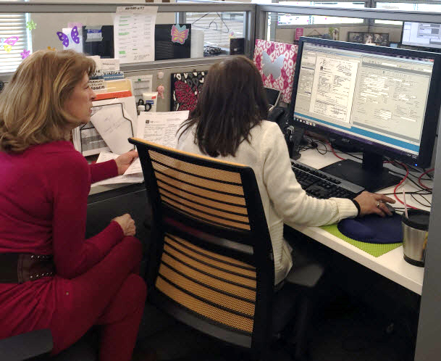
Listing of Changes
The following items have changed
Form changes, including ownership
Process changes, including to documents
Notes:
Let’s move on to the changes themselves. There are changes to the documents, including ownership. We’ll also cover process changes, of which there are few really important ones.

Slide 13
Form changes
Notes:
With that background, let’s move on to the changes made as a result of the selecting Walgreens Specialty Pharmacy to ship filgrastim. Before we move forward with the changes, are there any questions?

Slide 14
Form Ownership
Previous forms were owned by Biologics
New forms are owned and updated by NMDP
What does this mean for you?
NMDP Network Web site
Notes:
Previously, forms were owned by Biologics. New forms are now owned and updated by NMDP.
You can find updated forms on the Network Web site. Form updates, if any, will be communicated via Network notices (email). This will enable us to quickly post updates for you and keep you abreast of any changes.

Slide 15
Forms Current and New
Current Forms (Biologics)
New Forms (NMDP)
Filgrastim Order Form
Delivery Ticket/Verification of Contents
Tracking Slip
Filgrastim Administration Confirmation Form
F00825 – Neupogen® (filgrastim) Order Form
F00894 – Neupogen® (filgrastim) Shipping Information
F00826 – Epinephrine Auto-injector Order Form
F00862 – Filgrastim Delivery Ticket
F00869 – Neupogen® (filgrastim) Administration Confirmation
Notes:
As you can see from the listing of new forms, the order form, delivery ticket, and Filgrastim Administration Confirmation form have each been modified.
The tracking slip has been eliminated.
The Shipping Information and Epinephrine Auto-injector order forms have been added as new. We’ll go over each of these in detail.
Because Walgreen Specialty Pharmacy is incorporated in Pennsylvania, we now need to abide by the Pennsylvania’s pharmaceutical laws. As a result, some form information has changed and is additional to what you have done in the past. Prescription requirements are the most different.

Slide 16
Summary of the Most Notable Changes
You can fill out most forms electronically
The order form is two parts: Prescription & Shipping instructions
Orders require more information (e.g., Demographics/Allergies)
Epinephrine is prescribed and ordered separately
Notes:
Let’s look at some of the most notable changes to the forms:
You can fill out most forms electronically
The order form is now two forms, one for the prescription and one for the delivery instructions
Orders require more information such as demographics and allergies
It is also important to note that the CBC w/diff check box has also been eliminated from the filgrastim Order form. If a patient needs a blood draw, the prescribing physician needs to execute an additional order.
Epinephrine is now ordered separately. There is no longer an Epi check box to select on the filgrastim order form.

Slide 17
Neupogen® (filgrastim) Order Form
Current Form
Notes:
This is the current order form.

Slide 18
Neupogen® (filgrastim) Order Form
New Form
Prescribing providers must sign here!
Prescribing providers do NOT sign here.
Notes:
This is the new order form. You will notice the form now requires information regarding demographics, current medications, and allergy information.
Prescribing providers now sign in a different space on the form—here in the right column rather than at the bottom of the form. Please teach physicians to sign in the correct space.
The bottom signature is for prescribing a generic product. NMDP IND Protocol requires that filgrastim come from Amgen. This mean that all orders will only be filled with Neupogen. A generic cannot be substituted.
If a physician accidentally signed on the substitution (generic) line, you do not need to get another order signed. WSP will still only fill it with Neopogen, even if the substitution line is signed. Please let the provider know the location for correctly signing next time.

Slide 19
Neupogen® (filgrastim) Shipping Information
A New Form
Abbreviate
126 Washington Avenue North
Houston, TX 77002
To this:
126 Washington Ave N
Houston, TX 77002
Notes:
The Shipping form is new. The form contains the ship-to locations for all filgrastim orders and the contents of the shipped packages. You won’t see the shipping information on the prescription anymore. As an AC, you most likely will never see this form.

Slide 20
Epinephrine Auto-injector Order Form
A New Form
Notes:
If an epi pen is needed, you now place the order on a separate form, the Epinephrine Order form. The Epi check box has been removed from the Filgrastim Order form. Submit the epinephrine order form with the Filgrastim Order form and Shipping Information form.
The epinephrine form requires a separate prescribing provider signature. Donor Centers should only order Epinephine for emergency situations, meaning you have completed a thorough investigation of clinical site options and a clinical site is not available. Please ensure you complete due diligence.
Note also that because epinephrine is not part of the study, generic substitution is acceptable. Note that the form asks for the dose of Epinephrine auto-injector dose, which is its generic name.

Slide 21
Filgrastim Delivery Ticket
Current Form
Notes:
This is the former delivery ticket.

Slide 22
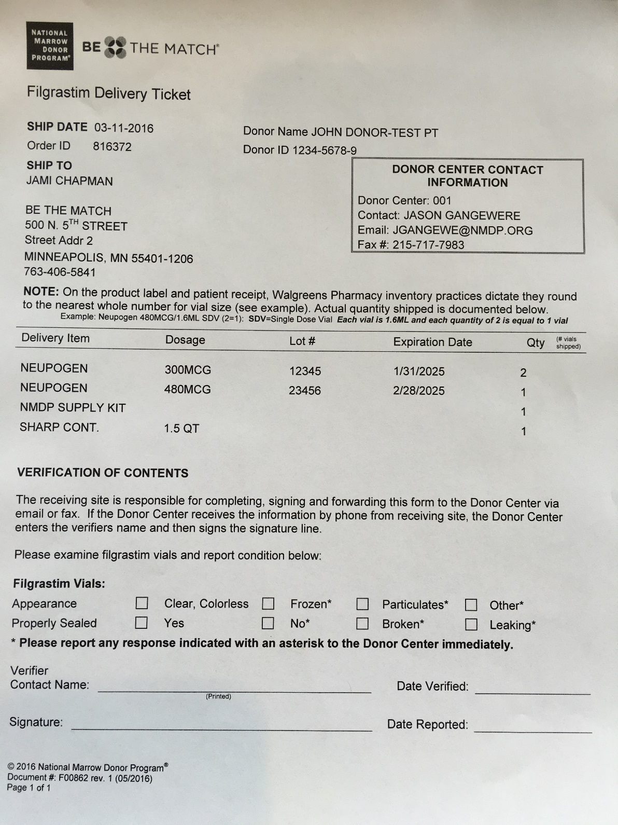
Filgrastim Delivery Ticket
Revised Form
1 dose of filgrastim = 1 ml
Notes:
The Delivery Ticket form has been refreshed. WSP includes this form in each shipment. It contains the following columns of information:
DID
Ship to address
Listing of vials
Lot numbers and expiration dates
And enables the receiver to record the appearance of the vials and whether or not they were properly sealed.
It is important to note that while Biologics counted their doses by number of vials, Walgreens Specialty Pharmacy counts their doses by mls. WSP considers 1 dose of Neupogen to be equal to 1 ml. Hence the quantity listed on the prescription label appears differently than it did with Biologics.

Slide 23
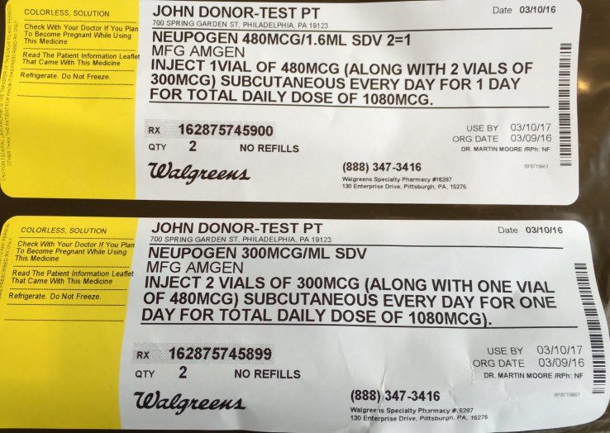
Filgrastim Delivery Ticket
Revised Form
Notes:
Let’s look at this example. Here we have a completed Delivery Ticket and its matching label. First, know that S-D-V stands for “Single Dose Vial”. Since the filgrastim vial with 480mcg is equal to 1.6 ml (red box), Walgreens rounds up and records the dose as 2, even though it is ONE VIAL. It will record the number of doses, not the number of vials on the prescription label.
That is why the prescription label records the Neupogen dose as 2 (or 480mcg/1.6ml SDV 2=1) and the Delivery ticket states that 1 480MCG vial is in the shipment (yellow highlight). The patient receipt replicates what is on the label.
The total daily dose of 1080MCG is then fulfilled with the remaining two vials of filgrastim at 300MCG each (purple highlights).

Slide 24
WSP Shipment inclusions
Notes:
Let’s talk a little about what happens at WSP after you submit an order for filgrastim.

Slide 25
Shipment Inclusions Summary
Every shipment will include
Shipments may include
Filgrastim in an amber bag
A00512 – Neupogen® (filgrastim) Quick Reference Guide
F00862 – Filgrastim Delivery Ticket
Filgrastim Information Sheet (WSP document)
Patient Receipt (WSP document)
Supply kit (if ordered)
Sharps container (if ordered)
Medication temperature indicator (Georgia only)
Notes:
In every shipment you will find the items listed above. If the shipment is directly to a donor, a supply kit and Sharps container may be included. Georgia requires a temperature indicator to be included in every shipment. Let’s look at each one in detail.

Slide 26
Shipment Inclusions
Every shipment will include
Filgrastim vials in an amber bag
Notes:
WSP uses an amber bag to ship filgrastim in order to ensure the drug’s protection from light.
Unlike Biologics, who shipped all 480 ml vials in one bag and all 300 ml vials in another bag, WSP will use single dosing, each amber bag will contain one daily dose for the donor (red boxes).

Slide 27
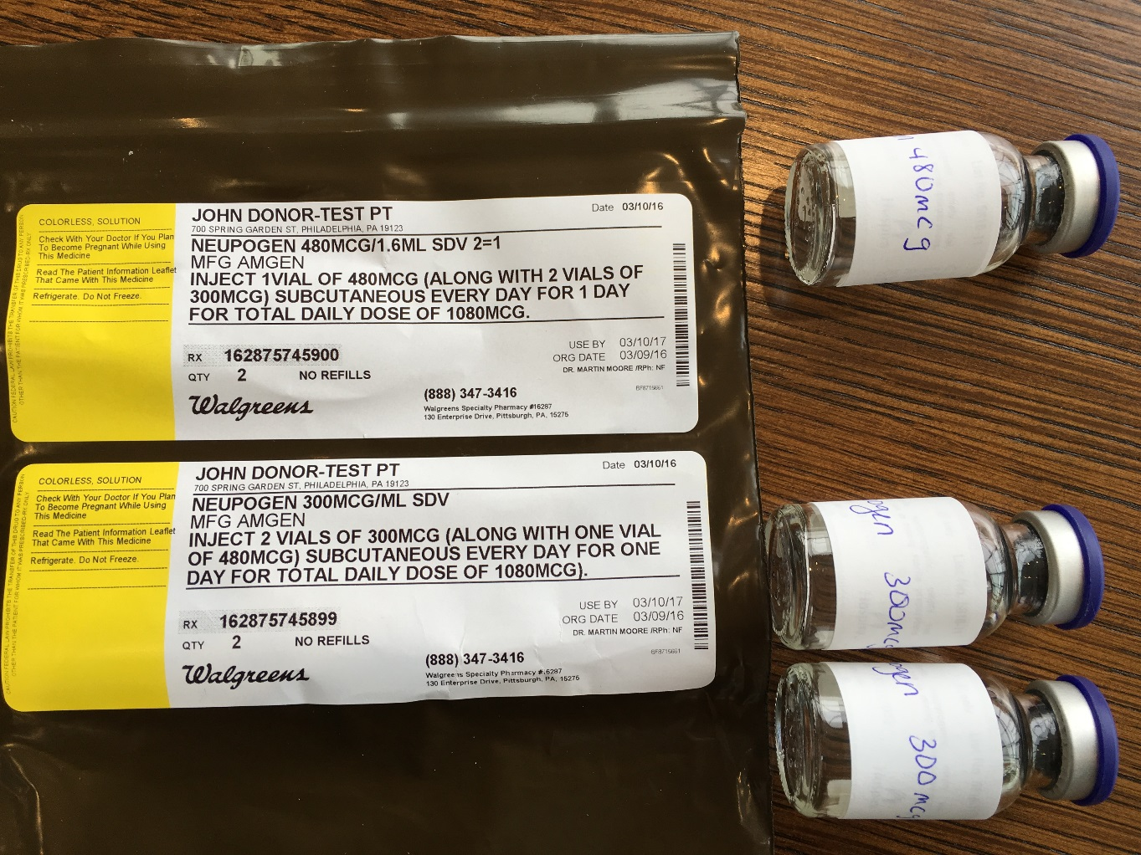
Shipment Inclusions
Every shipment will include
Filgrastim vials in an amber bag
Note: Vials shown here are labeled in pen for training purposes only. Vial labels are computer generated for patients.
Notes:
For example, if you are receiving three day’s worth of medication, you can expect to find 3 amber bags in the shipment. In this example, each bag will contain one vial of 480 ml and 2 vials of 300 ml.

Slide 28
Shipment Inclusions
Every shipment will include
Filgrastim Information Sheet
Notes:
The filgrastim Information Sheet contains detailed information about the drug. It is owned by Walgreens and part of their process.
The filgrastim information sheet contains one sheet each about the Neupogen 480 ml, one sheet about Neupogen 300 ml, one sheep about the supply kit (if included), one sheet about the sharps container (if included), and one sheet about the NMDP Plan of Treatment.

Slide 29
Shipment Inclusions
Every shipment will include
A00512 – Neupogen® (filgrastim) Quick Reference Guide
Notes:
The new Quick Reference Guide contains information about what to do once the filgrastim is received. It also includes administration instructions and the correct disposal of any remaining materials.

Slide 30
Shipment Inclusions
Every shipment will include
F00862 – Filgrastim Delivery Ticket
Notes:
The Delivery Ticket is similar to a packing slip. It is added and owned by WSP and used for all their shipments of medications.

Slide 31
Shipment Inclusions
Every shipment will include
Patient Receipt
Notes:
The patient receipt contains patient information, shipping method and details, and a detail of the package contents. This insert is owned by Walgreens and sent for their tracking purposes.

Slide 32
Shipment Inclusions
Shipment may include
Medication temperature indicator and instructions
State of Georgia ONLY
Notes:
The medication temperature indicator is included in all shipments going to the state of Georgia. This state requires the temperature indicator as part of the state’s regulations. Clear, easy–to-follow instructions are also included.

Slide 33
Support resources

Slide 34
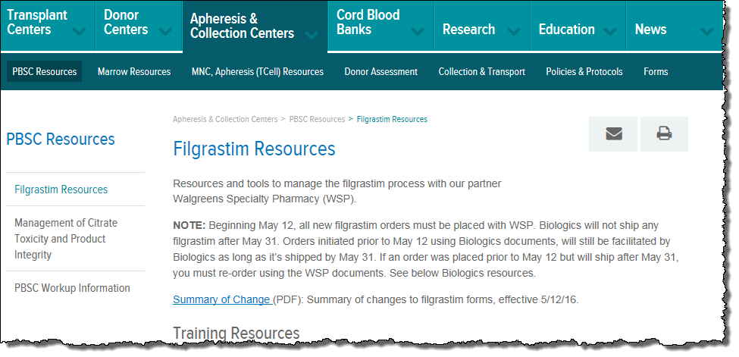
Support Resources
Filgrastim Resource Page - Network Web site
https://network.bethematchclinical.org/apheresis-and-collection-centers/pbsc-resources/filgrastim-resources/
Notes:
The filgrastim Resource Page on the network Web site contains all the new forms and support documents. It also has training for new staff in the form of elearning.

Slide 35
Questions?
For questions about the new process, please email AC-CCLiaison@nmdp.org.

